Slide 1
Partial Boosting of Deep Stacked Networks
Manuel Montoya-Catalá,
Ricardo F. Alvear-Sandoval,
Aníbal R. Figueiras-Vidal
UC3M / RAIng
Notes:
<number>
<number>
Hello everyone, mi name is Manuel Montoya and I-m here to present the paper Partial Boosting of Deep Stacked Networks that
my Collegues Ricardo F. Alvear and Anibal Figueiras Vidal have written
In this paper we aim to combine the expressivity of deep learning architectures and the resistance to overfitting of boosting.
This combination is non-trivial and there are many ways in which it could be performed.
The proposed architecture for this merging is a modification of the Deep Stacked Networks family
and the emphasis function is flexible enough to allow moderating the intensity of the emphasis function by
means of two combination constants.

Slide 2
Contents
Deep Stacked Networks
Boosting
Boosted Aggregated Deep Stacked Networks
Experiments
Algorithm properties
Conclusions
- 1 -
Notes:
<number>
<number>
So in this presentation I will first briefbly describe the two original training procedures we are combining.
Deep Stacked Networks architecture and the boosting ensemble.
Then I ll talk about the specific combination proposed in this paper.
After that, the experiments carried out for testing the architecture and their results.
Finally we ll see some of the properties of the architecture and the conclusions will close the presentation.

Slide 3
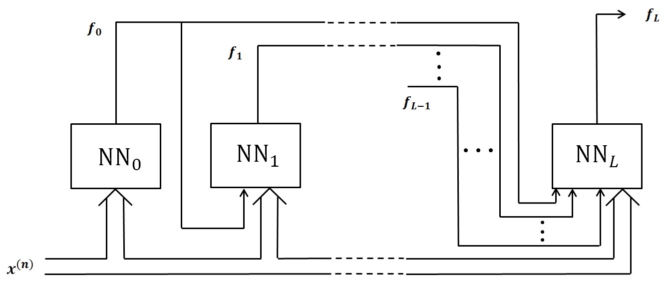
1. Deep Stacked Networks (DSNs)
Deep Learning architecture.
Each unit consists of a MLP whose input is:
The observed features and
the outputs of all previously trained learners.
The output of the DSN is the output of the last unit.
- 2 -
Notes:
<number>
<number>
Deep Stacked Networks are Deep Learning architecture
(designed for big, high dimensional, multiclass problems such as speech or image recognition).
Each layer of the Architecture consists of a MLP that is trained with:
The initial input features and
the outputs of all previously trained learners.
The output of the DSN is the output of the last unit.
The basic module of the DSN is similar to a Estreme Learning Machine.
They randomly initialize the weights of the hidden layer and obtain the weight of the output layer in a determinist manner
Performing a Least Squeare Regression of the output of the hidden layer.
Finer versions of the algorithm include initializing the weights assigned to the propagated outputs using a Restricted Boltzman Machine
And using bach-mode backpropagation to tune the network.

Slide 4
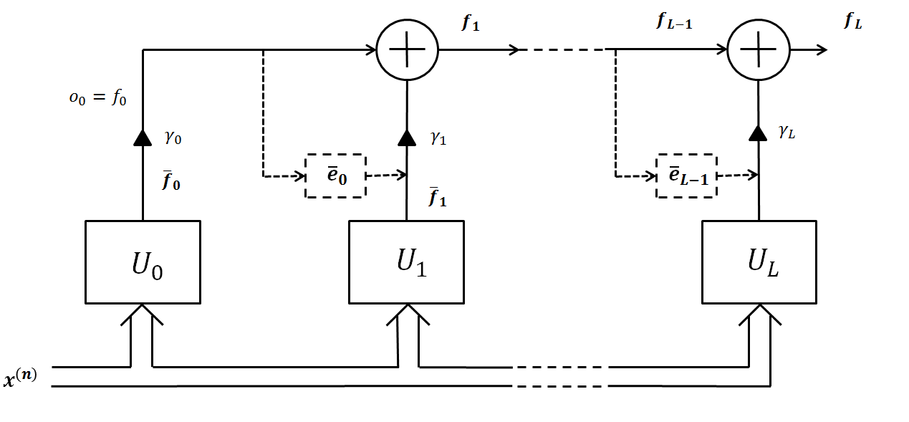
2. Boosting
Ensemble method in which weak learners are sequentially trained using information from the aggregation of all previously trained units.
Samples are weighted using a emphasis function.
The output of the ensemble is a linear combination of all unit outputs.
Resistant to overfitting.
- 3 -
Notes:
<number>
<number>
Boosting is an ensemble method in which weak learners are sequentially trained
using information from the aggregation of all previously trained units.
This information constists of an emphasis vector which assings a weight to each sample indicating the contribution
To each one of them to the loss function to minimize during training.
The output of the ensemble is a linear combination of all the outputs of the individual units.
Boosting is empirically known to be resistant to overfitting.
The combination constant for each learner is obtained using the emphasis function and the output of the learner.

Slide 5

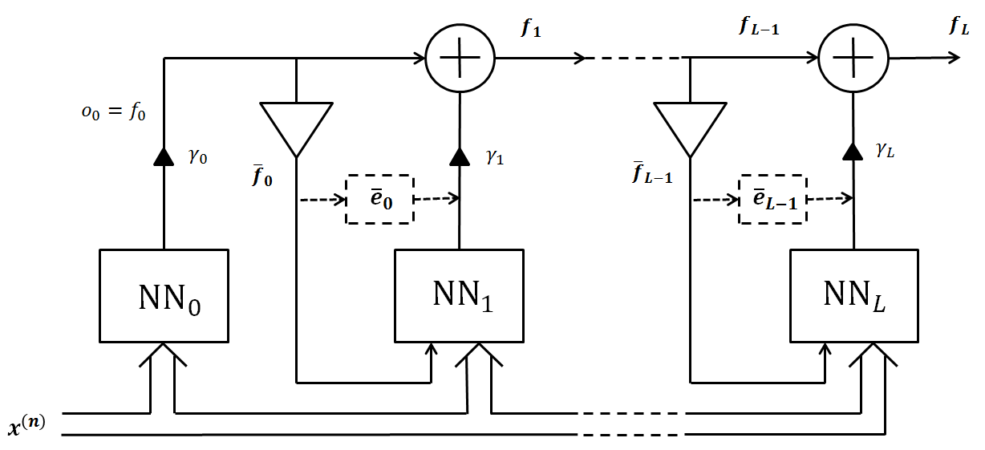
3. Boosted Aggregated Deep Stacked Networks
Combination of DSNs and Boosting by means of an aggregated output injection and a flexible emphasis function. Each unit has 2 additional sources of information:
Injection of the aggregated output of all previously trained units
Emphasis function
- 4 -
Notes:
<number>
<number>
The proposed architecture Boosted Aggregated Deep Stacked Networks
Is a combination of DSNs and Boosting by means of an aggregated output injection and a flexible emphasis function.
Each layer has 2 additional sources of information:
Injection of the aggregated output of all previously trained units. Instead of injecting all the previous outputs separately, we combine them linearly using the Real AdaBoost combination equation. This injection is normalized before to avoid the dominance effect.
Emphasis function
The emphasis function is flexible enough to be able to moderate the intensity of boosting,
It contains a convex combination of a constant term and an error dependent term using the parameter alpha.
Parameters alpha and beta are obtained by cross-validation.
There is another emphasis function which is a generalization of RAB also used.
In the image we can see the two sources of information, and the output of the system is the aggregated output, like in boosting.

Slide 6
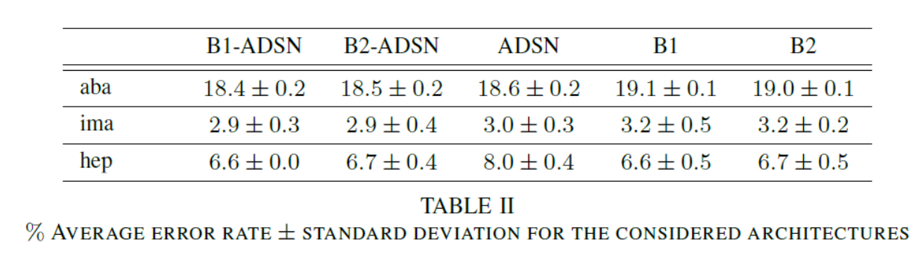
4. Experiments
Experiments performed over a set of modetate size binary problems.
Units are MLP sequentially trained using Online Back-Propagation.
Explored values of the non-trainable elements in the CV-search are:
Number of hidden neurons from 2 to 30.
Number of epochs from 25 to 200.
- 5 -
Notes:
<number>
<number>
Now we ll talk about the experiment. To test the properties of the new architecture, we used a set of well known small size binary problems.
They have different properties, like Abalone has more samples and is balance, image is less balanced and hep has low samples and is quite unbalanced.
Units are trained using Online Back-Propagation.
Explored values of the non-trainable elements in the CV-search are:
(the emphasis function parameters) go from 0 to 1 in 0.1 steps
3 datasets are presented, the first is the hardest one and has the highest number of samples, ima has half of the samples and hep has very little samples.
In cases where the problem is easy (hep) and are prone to overtiffing, the injection could lower the accuracy.
The results are always better than ADSN
Now we ll talk about the experiment. To test the properties of the new architecture, we used a set of well known small size binary problems.
They have different properties, like Abalone has more samples and is balance, image is less balanced and hep has low samples and is quite unbalanced.
Units are trained using Online Back-Propagation.
Explored values of the non-trainable elements in the CV-search are:
𝛼,𝛽 (the emphasis function parameters) go from 0 to 1 in 0.1 steps
About the results !!!

Slide 7
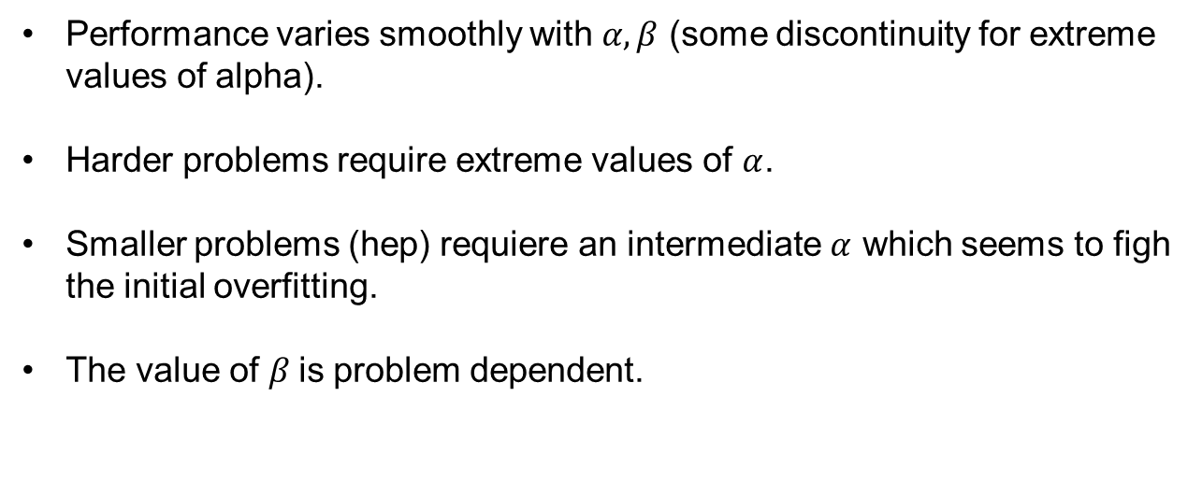
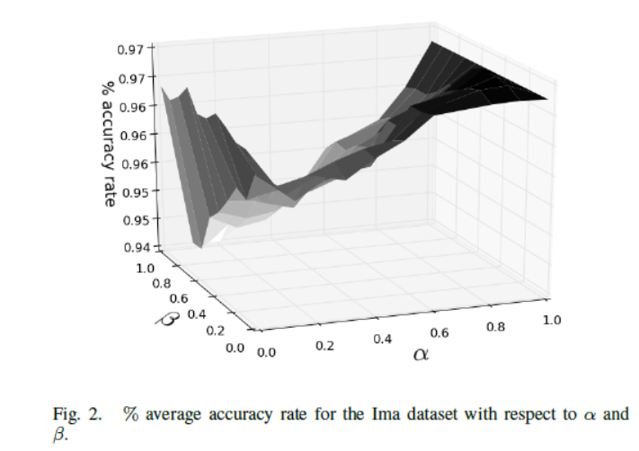
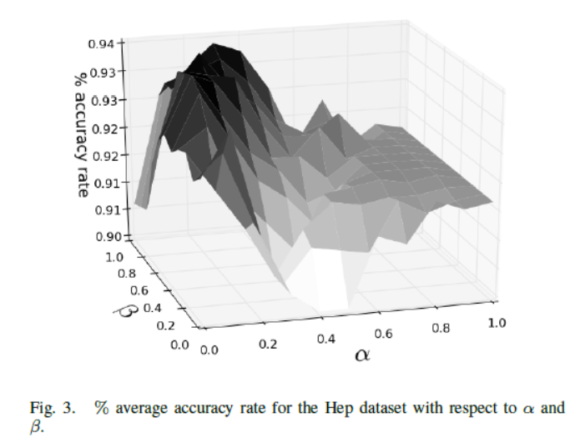
5. Properties of the B-ADSNs
Performance varies smoothly with (some discontinuity for extreme values of alpha).
Harder problems require extreme values of .
Smaller problems (hep) requiere an intermediate which seems to figh the initial overfitting.
The value of is problem dependent.
- 6 -
Notes:
<number>
<number>
The two graphics below show the behaviour present in many other tested databasets.
The figures show the accuracy for test with respect to alpha and beta for the ima and hep datasets.
The emphasis function used is a generalizaiton of the Real Adaboost funtion, for alpha = 0 and beta = 0.5.
The shapes vary smoothly with the number of hidden neurons. .

Slide 8
6. Conclusions
The combination of the expressivity of DSNs and the resistance to overfitting of boosting can be succesfull.
A flexible emphasis function is required to modetate the boosting contribution.
There are many other possible combination of boosting and deep learning.
- 7 -
Notes:
<number>
<number>

